Slide 1
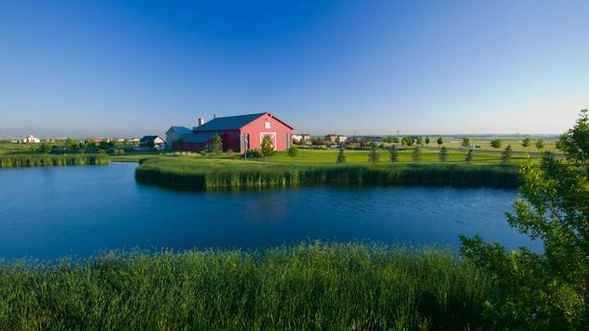
District and Litigation Background

Slide 2
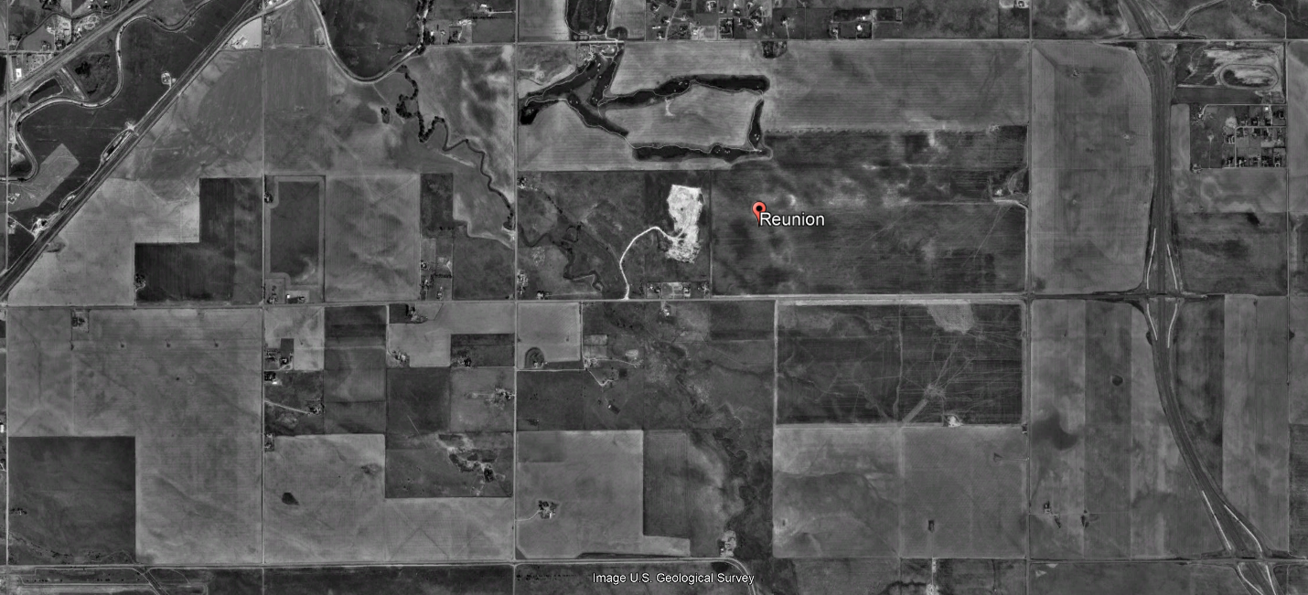
Reunion Area 1999

Slide 3
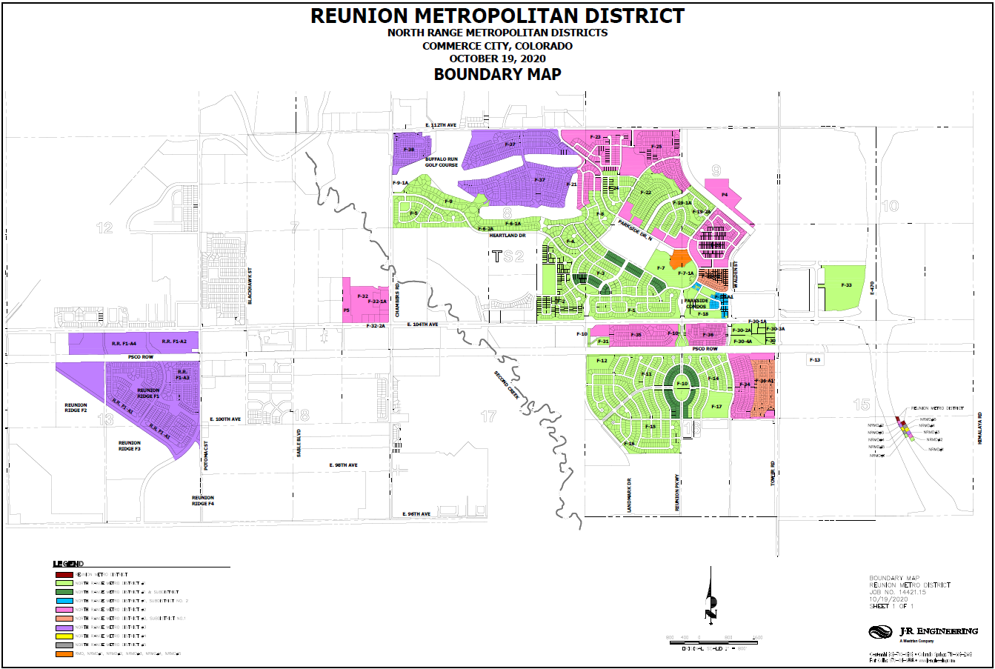

Slide 4
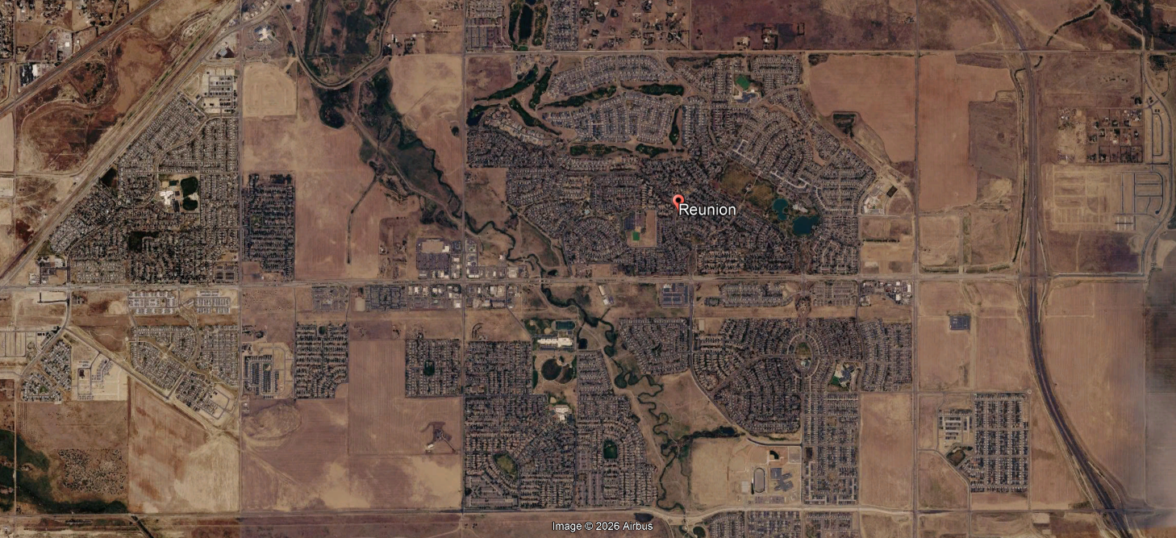
Reunion Area 2026

Slide 5
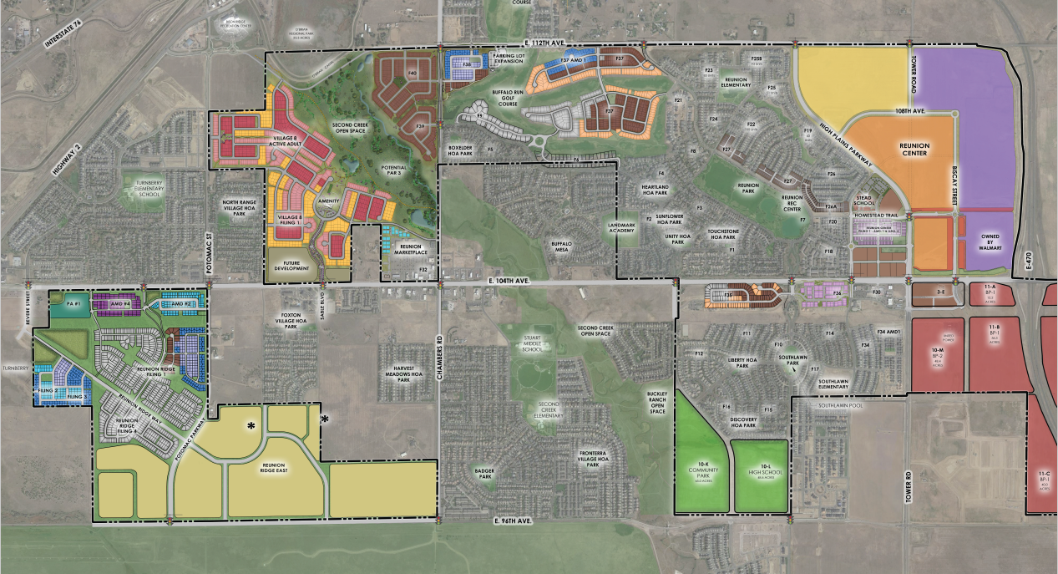
Reunion Illustrative Development Plan
Graphic is illustrative and subject to change

Slide 6
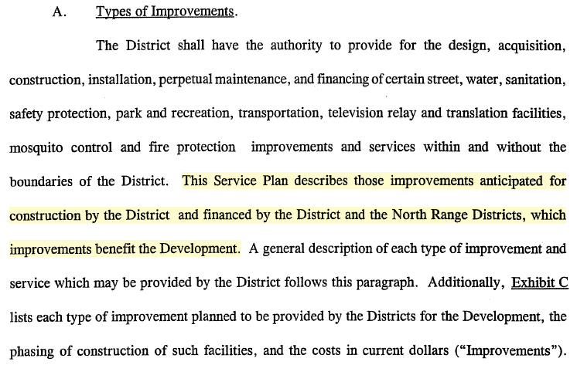
Improvements Installed and Financed
Examples
  Roads, traffic signals
  Sewers
  Storm drainage, underdrainage systems
  Water system
  Landscaping, parks, ponds, irrigation
  Reunion Recreation Center
  Southlawn Pool
  Design and construction costs for improvements
Bonds Generated Approximately $127 million in Project Funds

Slide 7
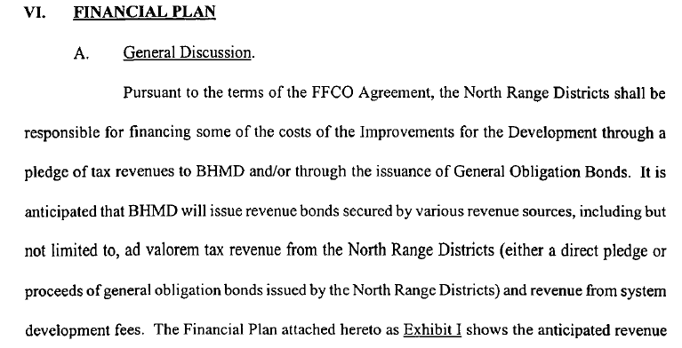
Service Plans, Section VI.

Slide 8
Refinancing Proposal

